Slide 1
Evolutionary Fuzzing Framework
By Maria Rakotyansky
Advisor Neer Roggel (Intel Corporation)
Notes:
Today I’d like to present our project which is called Evolutionary fuzzing framework. It was offered by Intel Corporation. Our advisor is mister Neer Roggel. The team members are Maria Rakotyansky and Felix Beilis. First I’’ll say a couple of words about the project in general and then will pass to the part that I have done.

Slide 2
Outline:
Project motivation
What is fuzzing
Peach Fuzzer platform
Genetic algorithms
Project description
Problems and difficulties
Experiment results
Conclusions
References
Notes:
I’d like to start with a short outline of the todays presentation. It will include several min points.
First of we should understand what is the project motivation: why is the project necessary, why it might be important. Then we’ll discuss the idea of fuzzing, what stand behind this term. This information is necessary to understand what idea stands in the basis of the project. Then Peach Fuzzer platform , the tool used in the process of development. A short introduction into evolutionary algorithms, it will give us some basics to understand the main concept of the priject
An d finally conclusion.

Slide 3
Project Motivation
Software vulnerability
A security exposure that results from a product weakness that the developer did not intend to introduce and should fix once it is discovered.
Exploitable vulnerability
Vulnerability that depends or can be influenced by user input.
Possible solution - Black Box Analysis
Easily automated
Not require access to source code
Notes:
The vulnerabilities are found in all software.
These might let the attacker violate the confidentiality, access control, etc.
The basic concept is the following : You are able to input data in the process which is acted upon. If the algorithm is insufficient bad data will trigger vulnerability that will result in unpredicted behavior within the process.

Slide 4
What is fuzzing?
A way of vulnerability analysis
How?
Injection of malformed input into a program and monitoring for crashes
Types of fuzzers:
Mutation: Dumb Fuzzing
Mutate existing data randomly
Generation: Smart Fuzzing
Define tests based on predefined input models
Evolutionary:
Input generation is based on output evaluation
Notes:
Many bugs are the result of programmer oversights or assumptions regarding the structure of user supplied input.
There are no real rules for fuzzing. It is a technique where success is measured solely by the results of the test. For any given product there may be an infinit number o inputs you can provide. And fuzzing is the process of predicting what types of programming errors may exist in the product and the inuts that will trigger those errors.
Fuzzing is an approach to software testing where the target software being attacked with test cases generated by another program. The target software is then monitored for any crashes exposed by the processing of this input. The basic principles of fuzzing remain unchanged, but the mechanisms used to make the fuzzing process more effective have undergone serious changes.
Currently fuzzers can be subdivided into 3 groups:
Mutation Fuzzers
This type is also called Dumb. It is based on the random mutation of the input.
Generation Fuzzers
This type is also called Smart. It defines tests based on predefined input models.
Evolutionary Fuzzers
Here input generation is based on output evaluation.

Slide 5
Peach Fuzzer platform
Peach(Smart Fuzzer)
Open Source Software
Advanced and extensible fuzzing platform
Designed for security researchers, consultants and companies
Peach fuzzes files using 3 techniques:
Modeling
Mutating
Monitoring
Notes:
Peach Fuzzer is an advanced fuzzing platform. It was designed to speed up the development of fuzzers for security researchers, security teams, consultants and companies. The tool is very flexible and allows modeling the data to be used in the process of fuzzing.
Peach fuzzes files using three techniques: modeling, mutating and monitoring.
Modeling
Peach uses data models which contain data format down to the field level. Based on your data models, Peach knows each data field’s size and format. Each time you test your software, Peach uses state models that tell Peach how to send data to and receive data from your product.
Mutating
Peach uses the information in your data models and parameters you supply and mutates your data files. Mutations are designed to reveal security vulnerabilities; they use your data’s existing values and either modify them or produce completely new data.
Monitoring
While Peach is running, it monitors your target and environment to identify faulting conditions and collects information you can use to investigate and remediate the faults. During the fuzzing session, Peach uses processes such as fault detection and data collection to monitor the fuzzing run results. Based on the parameters you supply, Peach can capture network traffic during a fuzzing iteration, attach a debugger to a process to detect crashes, or even restart a network service if it crashes or stops.
When fuzzing is complete, all the relevant information is saved in the Peach log files. It can easily be used to reproduce the issue in the code (with a debugger running) for further error analysis. This can help to determine where to correct the problem(s).

Slide 6
Peach Fuzzer platform
Peach(Smart Fuzzer)
Modeling
Use of data models containing data format
Mutating
Data file mutation
Monitoring
Monitors target and environment to identify faulting conditions and collects information
Relevant information is saved log files
Easy fault reproduction
Simple error analysis
Notes:
Peach Fuzzer is an advanced fuzzing platform. It was designed to speed up the development of fuzzers for security researchers, security teams, consultants and companies. The tool is very flexible and allows modeling the data to be used in the process of fuzzing.
Peach fuzzes files using three techniques: modeling, mutating and monitoring.
Modeling
Peach uses data models which contain data format down to the field level. Based on your data models, Peach knows each data field’s size and format. Each time you test your software, Peach uses state models that tell Peach how to send data to and receive data from your product.
Mutating
Peach uses the information in your data models and parameters you supply and mutates your data files. Mutations are designed to reveal security vulnerabilities; they use your data’s existing values and either modify them or produce completely new data.
Monitoring
While Peach is running, it monitors your target and environment to identify faulting conditions and collects information you can use to investigate and remediate the faults. During the fuzzing session, Peach uses processes such as fault detection and data collection to monitor the fuzzing run results. Based on the parameters you supply, Peach can capture network traffic during a fuzzing iteration, attach a debugger to a process to detect crashes, or even restart a network service if it crashes or stops.
When fuzzing is complete, all the relevant information is saved in the Peach log files. It can easily be used to reproduce the issue in the code (with a debugger running) for further error analysis. This can help to determine where to correct the problem(s).

Slide 7
Genetic Algorithms
General Notions
Population
Citizen = problem solution
Genome
Citizen's properties
Fitness
How good the citizen is?
Selection
Choice of candidates for reproduction
Crossover
Using genes of a pair of existing parents to create a new child
Mutation
Modification of existing gene
Notes:
Genetic algorithms are a model of machine learning which mimics the evolutionary processes in nature. They were introduced in the United States in the 1970s by John Holland at University of Michigan. This method finds application in computational science, economics, chemistry, bioinformatics, etc.
Population
To use the evolutionary approach a population of individuals should be created where an individual (creature, citizen) represents solution to the problem.
Genome
Each candidate solution has a set of properties called genomes (chromosomes). These properties can be altered.
Fitness
The fitness value determines how good the individual is at competing at its environment. A good and effective fitness function should take into consideration all characteristics of a desired solution.
Selection
Selection is the choice of candidates for reproduction. The strategy is usually determined by the fitness measure. Very often only a small part of population takes part in breeding and replacement of the previous generation.
Crossover
Crossover is the process of using genes of a pair of existing parents to create a new child. It involves splitting source individuals in accordance to predefined rules and swapping chunks of their chromosomes.
Mutation
It is a random process (probability might be redefined) which slightly modifies the individual’s gene. Mutation is a good way to avoid premature convergence.

Slide 8
Genetic Algorithms
Selection strategies
Fitness Proportionate Selection (FPS) aka Roulette
Tournament Selection
Naïve selection
Survival strategies
Elitism
Aging
Genitor

Slide 9
Project Description
Project aim:
Produce efficient input used in fuzzing by means of combination of evolutionary algorithms.
Show why the chosen approach is good.
Notes:
In our project we tried to develop a simple and effective tool which by means of combination of evolutionary algorithms will be able to produce efficient input used in the process of fuzzing

Slide 10
Project description
Project requirements:
Develop fuzzing framework
Based on Peach fuzzer
Automated input generation
Use genetic algorithms
Design fitness function
Feedback from heuristics(output analysis)
Generate input on the basis of analysis results
Notes:
GA – a search algorithm that works via the process of natural selection
Reproduction – copy of potential solution
Crossover or mutation (swap gene between 2 potential solutions or act of randomly altering the value of a gene in a potential solution)
Fitness value reflects how optimal the solution is.

Slide 11
Project description
Input
Generation
Analyze Result
Execution
Check Behavior

Slide 12
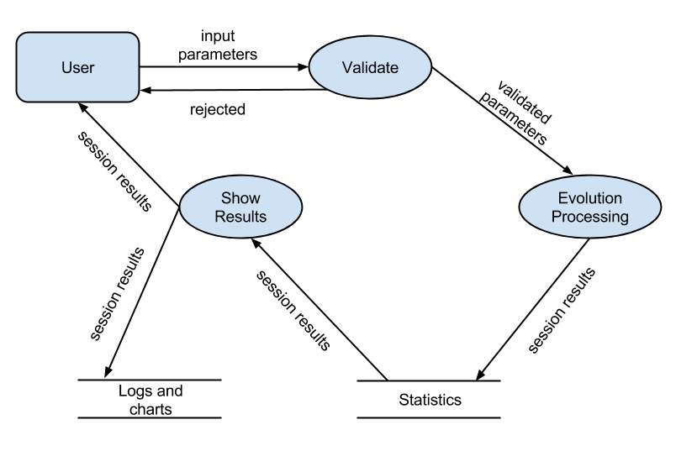
Pit File Mode
Population:
Modified (mutated) PeachPits
Origin – Peach Pit file prepared by user
Data Flow Diagram
Notes:
After the discussions it was decided that Evolutionary Fuzzing Framework Project will have 2 modes of working (subprojects) : Pit File Mode and Modified Input Mode. The Pit File mode will use as population modified (mutated) PeachPits. The Modified Input Mode will use as population modified (mutated) input files created from the same PeachPit.
The current report describes only Pit File Mode of the Fuzzing Framework Project. For the purpose of simplicity Pit File Mode will subsequently be referred as Subproject.

Slide 13
Problems and difficulties
Peach Fuzzer platform faults
Peach Peat file is sensitive to the changes. Peach program does not pass the stages of data cracking
Performance
Time of test run is quite long
Example:
100 citizens, 10 iterations, test range - 30
test time – 3 sec, performance time - 25 hours

Slide 14
Experiment results
Target - Cutezip Archiver
Peach Pit file – zip format
Best result – Tournament
Worst result – FPS with low mutation probability
Conclusion :
Not all genetic algorithms are equally effective.
Need balance between randomness and good genes preservation
Promising method, but needs more experiments to collect data

Slide 15
Conclusions
New knowledge:
C# skills
Fuzzing testing technique
Genetic algorithms
Peach Fuzzer platform usage
Work with xml files
Project management skills

Slide 16
References
References for fuzzing testing technique:
Fuzzing Techniques: https://www.owasp.org/index.php/Fuzzing
S.Bekhar, C. Bekhar, R. Groz, L. Mounier A Taint Based Approach for Smart Fuzzing
Smart Fuzzing: http://trace.tennessee.edu/cgi/viewcontent.cgi?article=2402&context=utk_graddiss
Evolutionary fuzzing: http://www.defcon.org/images/defcon-15/dc15-presentations/DeMott_Enbody_and_Punch/Whitepaper/dc-15-demott_enbody_and_punch-WP.pdf
References for Peach Fuzzer Platform:
Peach Fuzzer page: http://peachfuzzer.com/
Peach Example.pptx (see directory DocumenationAndInformationUsed)
References for creating Peach Pit files:
Tutorial: http://www.flinkd.org/2011/07/fuzzing-with-peach-part-1/
Peach 2.3: http://old.peachfuzzer.com/v2/peach23.html

Slide 17
References
References for genetic algorithms:
Beginners Guide to Evolutionary Algorithms: http://www.perlmonks.org/?node_id=298877
Evolutionary algorithms: http://www.talkorigins.org/faqs/genalg/genalg.html
Crossover: http://geneticprogramming.us/Genetic_Operations.htmlhttp://www.obitko.com/tutorials/genetic-algorithms/crossover-mutation.php http://cswww.essex.ac.uk/staff/poli/gp-field-guide/24RecombinationandMutation.html
Genetic Algorithms overview: http://www.geocities.ws/francorbusetti/gabeasley1.pdf
References for documentation preparation:
ProgrammerGuideHowTo.pdf (see directory DocumenationAndInformationUsed)
830-1998SRS.pdf(see directory DocumenationAndInformationUsed)
Business vs. System Cases.pdf (see directory DocumenationAndInformationUsed)

